Slide 1
HL7 Tooling Challenge 2012
"Produce a UML Profile for MIF Static Models"
Submission from Michael van der Zel
<m.van.der.zel AT umcg.nl>
2013-jul-01
Files are located at : http://gforge.hl7.org/svn/toolchlge_001

Slide 2
Intro
Challenge: "Produce a UML Profile for MIF Static Models - This is a task so that other modeling tools have a chance to be configured to understand MIF."
Sidenote: UML "friendly" Profile for HL7 MIF Static Models
My focus: Functionally Equivalence
Previous work by: AMS, Dave Carlson, Graham's notes in the MIF XML Schemas, http://wiki.hl7.org/index.php?title=Requirements-Static_Model
Keep in mind the ongoing OMG AML work

Slide 3
Method
Used MIFs 2.1.6 from NE2013
  Main difference with MIF 2.2.0.0 is in the vocab part
  Could not get the xslt 2.1.6 > 2.2.0 to run
EA MIF Profile (shapes for Choice, EntryPoint, Refs)
Created import using XSLT and MAX XML
Toolchain: MIF -> XSLT (Eclipse) -> MAX -> EA (with MIF Profile)-> MAX (-> XSLT -> MIF)

Slide 4
Deliverables
Files are located at : http://gforge.hl7.org/svn/toolchlge_001
MIF2.eap with the MIF2 UML Profile, Manual Examples and the MAX versions imported
HL7-MIF2 Profile.xml
MIF216toMAX.xslt for transforming MIF's to MAX format with the UML Profile applied.
*.max.xml MAX versions of RIM, R_AssignedPerson informational, E_Organisation Informational
MAX_EA_Extension <dd>.setup.msi for importing the MAX files into EA

Slide 5
Additional Objectives
From: http://wiki.hl7.org/index.php?title=HL7_Tooling_Challenge#Additional_objectives
Produce a MIF to XMI XML transform consistent with the updated UML Profile.
  MZ: Created a MIF to MAX transform that imports in EA (UML)
Produce a viewer that can browse MIF schemas (Meta level)- this task makes it easier to understand the relationship among the MIF files and their elements.
  MZ: Used Eclipse XML Schema Browser
Produce a viewer that can browse MIF based models (model level)- this task makes it easier to understand the serialized models expressed in MIF XML.
  MZ: Using the MIF to MAX and then import in EA to do browsing
Produce a viewer that can browse instances from MIF based models (instance level) - this task makes it easier to evaluate instances based on serialized MIF models.(there is some work that already exists)
  MZ: Not done

Slide 6
Results
In the following sheets you will find:
Used as is: Classes, Attributes, Constraints, Associations
Mapping MIF to UML
Handling derivedFrom and attribute order with sortKey
Issues identified
TODO
Resulting UML Profile
Manual Example and Imported through MAX MIF Example
Special EA features used

Slide 7
Mapped MIF on UML (1/2)
N.B. Detailed mapping is in the XSLT
UML Stereotype MIF
Package StaticModel staticModel
StaticModelRef derivedFrom/targetStaticModel
StaticModelRef importedDatatypeModelPackage
StaticModelRef importedVocabularyModelPackage
StaticModelRef importedCommonModelElementPackage
Interface EntryPoint entryPoint
CommonModelElementRef containedClass/commonModelElementRef
Class Choice containedClass/class[not(attribute)]
- containedClass/class[attribute]

Slide 8
Mapped MIF on UML (2/2)
N.B. Detailed mapping is in the XSLT
UML Stereotype MIF
Association association
Directed Association entryPoint
Generalization containedClass/class[parentClass]
Dependency DerivedFrom staticModel/derivedFrom
Dependency Import importedDatatypeModelPackage
Import importedVocabularyModelPackage
Import importedCommonModelElementPackage

Slide 9
Handling derivedFrom
MIF Import:
  In the MIF only the derivedFrom stuff is there that is used, without the full referenced models can only do a partial reconstruction in the <derivedFrom> <StaticModelRef>
MIF Export:
  DerivedFrom derivable from the UML Model Inheritance

Slide 10
Handling Attribute sortKey
MIF Import:
  EA keeps attribute order (using Tpos) and MAX assumes order is significant
MAX Export:
  In EA order can be changed. In the export sortKey is set to Tpos

Slide 11
Issues (1/2)
Missing Information in the MIF but in the Visio Diagram
  Constraints
  Alias of CMET's used, e.g. COCT_MT150007UV, it is now referenced by name E_OrganizationInformational
There is no explicit Choice definitions in the MIF, now assume if a class has no attributes that it is a Choice
Mandatory?
Why is EntryPoint a Class? Class can be derived from Class that EntryPoint points to.

Slide 12
Issues (2/2)
Conformance
  Looked at a couple of MIF's and they only have conformance="R" attributes. Is this used?
  Possible solution: use UML Attribute qualifiers for this?
ChildClass
  In UML the parent of a class is with that class and not in its parent.
Shadow Classes
  Ignored for now. Just make reference to actual class. This is only a diagramming thing.

Slide 13
TODO
XSLT from MAX back to MIF (basis is there)
  MAX2MIF220.xslt
Vocabulary part in import. Now have manual example
Reconstruct the partial derivedFrom classes in their associated packages or reference the actual imported package/StaticModel (RIM, DMIM, RMIM, CMET)

Slide 14
MIF2 UML Profile

Slide 15
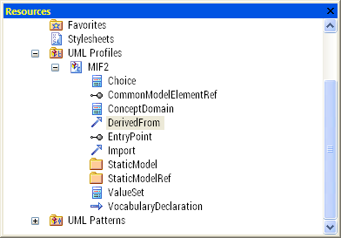
MIF2 UML Profile Usage
As it will show in EA.

Slide 16
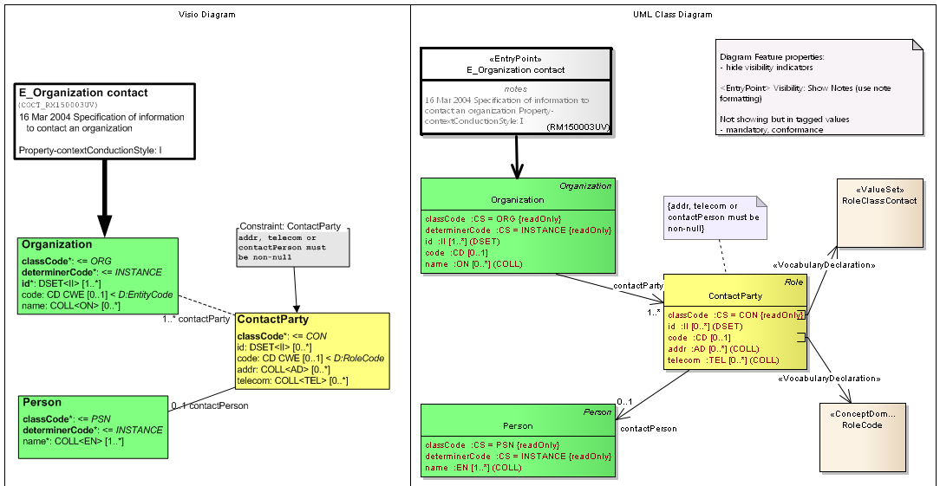
Manual Example
TODO: Use derivedFrom
TODO: Use this notation in the import also.

Slide 17
R_AssignedPerson informational
(Package Diagram from Import)

Slide 18
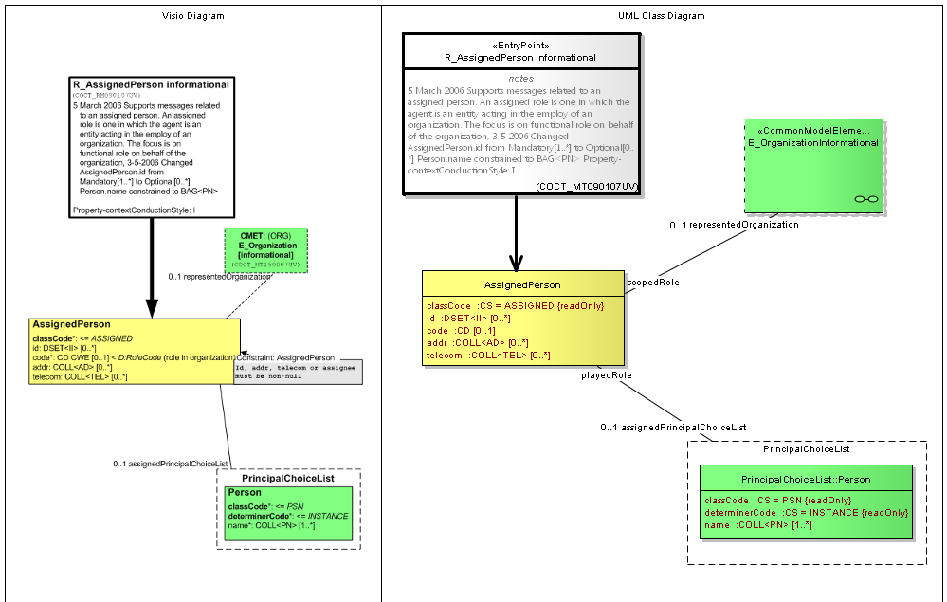
Compare (imported) R_AssignedPerson informational
Double click in EA diagram opens CMET Diagram

Slide 19
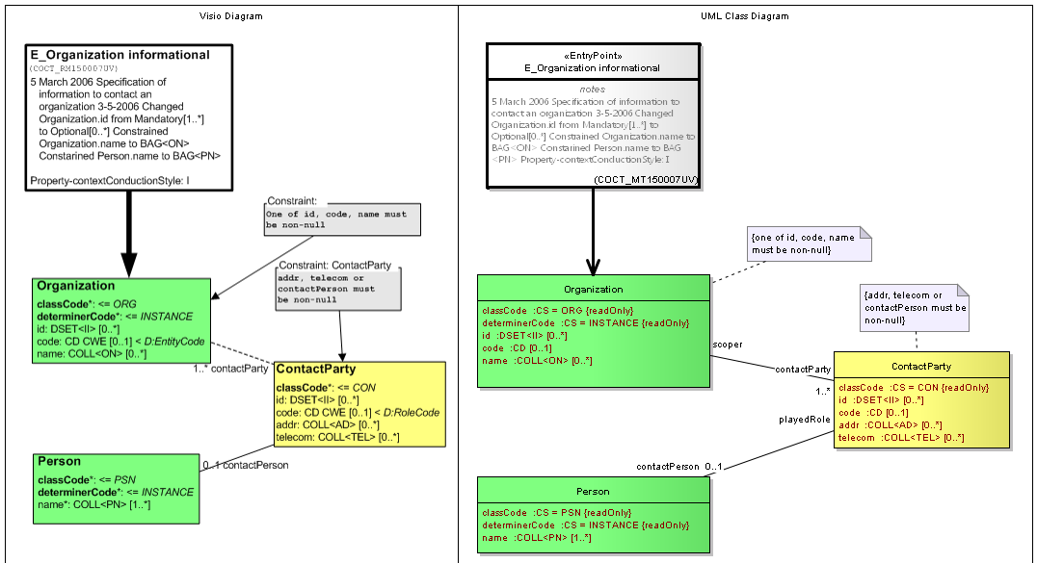
Compare (imported)
E_Organization informational
Constraints are NOT in the MIF, added manually.

Slide 20
Special EA Features
(Profile) Shape Scripts for Stereotypes:
  EntryPoint – whitefill,border=3, +alias, +notes
  XxxRef – extra dashed rectangle
  Choice – dashed line, +composite diagram for children
(Diagram) Composite Diagram
  For children in Choice
  For double click jump to subdiagram of e.g. CMET's

Slide 21
EA Extra (1/2)
Diagrams are now manual, layout, RIM colors, composite diagrams for referenced CMET's
Extend MAX with <diagram> section to also support the mif:graphicRepresentation import
Create MIF Extension to EA with functions:
  Apply RIM colors. For this the inheritance (derivedFrom) needs to be walked and all the RIM classes have an associated color.
  Find package/StaticModel based on the XxxRef. Jump to package/StaticModel containing actual definition.

Slide 22
EA Extra (2/2)
Validation of Models – UML allows more than MIF Static Models, e.g. dependency association or aggregation. This is to check the model against the rules of MIF Static Models, restricting types of associations in the MIF UML Static Models.
  use EA's validation Extension
  or validate through MAX Schematron (as demonstrated in the EHR-S FM Profile Tool Phase 1)

